Slide 1

Serving Veterans and family members with limited English proficiency (LEP) Overview and VA.gov vital content approach
A report from the VA Office of the Chief Technology Officer (OCTO)

Slide 2
Need: Reduce barriers to access and rebuild trust in government through multilingual content
Executive Order 13166 on Improving Access to Services for Persons with Limited English Proficiency (2000)
Executive Order on Advancing Racial Equity and Support for Underserved Communities Through the Federal Government (2021)
Executive Order on Transforming Federal Customer Experience and Service Delivery to Rebuild Trust in Government (2021)
H.R.2093 - Veterans and Family Information Act (2021)

Slide 3

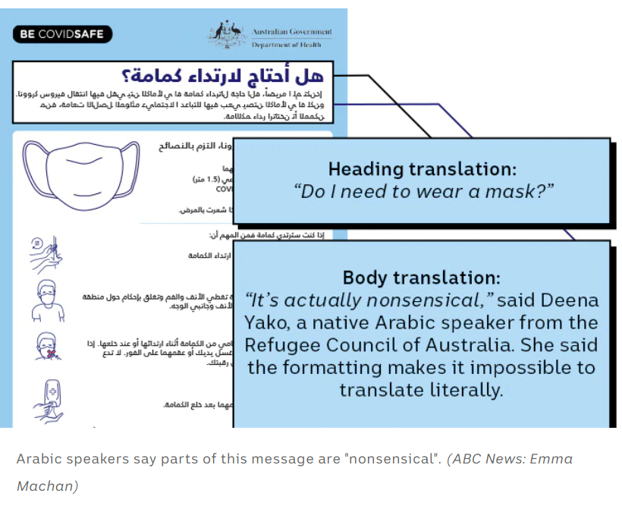
Problem: VA isn’t set up to deliver on this need
The need for multilingual COVID-19 content highlighted the fact that VA is not set up for providing this content (with technical solutions, processes, or people)—and that “quick and easy” solutions aren’t the answer.

Slide 4
Discovery inputs
Policy guidance review
Data and analytics review (population data, VA data, VA.gov analytics)
Best practice literature review
Technical landscape and options review (ongoing)
Interviews with 8 government multilingual agency teams and the leader of the gov multilingual community
Interviews with VA partners who serve or manage multilingual content for target audience
Technical approach survey with 9 responses from private sector companies (7 Fortune 500 companies)
Veteran usability research (ongoing and welcome more from all of you!)

Slide 5
5 guiding principles for VA multilingual content
Relevancy: Determine the right mix of solutions and priority content for each language based on limited English proficiency needs within the Veteran community.
Quality: Create multilingual content that is clear, accurate, timely, and culturally relevant.
Accessibility: Make sure that translated content is accessible to all who need it, including those with low or no vision or hearing, low literacy, and cognitive issues.
Equity: Take the same care with multilingual content as we do with English content. And create solutions that are equitable for all (including bilingual VA employees who should not be asked to translate content as an unpaid add-on to their job).
Sustainability: Scope translation content and solutions appropriately and establish foundational processes and systems to maintain quality over time.

Slide 6
Discovery highlights: Languages
There is an LEP need among both Veterans and family members. In the 2014 American Community Survey, for example, 100k+ Veterans reported having LEP.
Spanish is the top language of need by far on every measure. These include top languages spoken by Veterans who are immigrants to the U.S., engagement level on VA.gov, volume of interpreter requests, LEP share, and projected population growth.
Chinese and Korean are the next top languages of need. This is based on engagement on VA.gov, top languages spoken by Veterans who are immigrants to the U.S., and LEP share.
Vietnamese, Haitian Creole, Tagalog, German, and French are also languages of important consideration. Others to track include Japanese, Farsi, and Native American and Alaska Native tribal languages.

Slide 7
Discovery highlights: Spanish content needs
Health care and disability are top content and forms
Debt, appointments, and travel pay are top search terms
Almost 3/4s of Veterans who identify as Hispanic or Latino and are eligible for VA health care receive their care through VA—and do so regularly and more frequently than the overall Veteran population.
Veterans who identify as Hispanic or Latino have higher rates of certain health conditions, such as diabetes. VA has shown that a culturally and linguistically appropriate VA diabetes management program offered participants significant improvement in diabetes control.
“For me, it would be more important on how to make appointments and how to apply for benefits.” —Spanish-speaking LEP Veteran research participant

Slide 8
Discovery highlights: Processes and people
Top shared challenges among agencies:
Scoping and prioritizing content based on need
Keeping translated pages synchronized
Staffing and undue burden on bilingual employees
Turnaround times
Plain language and consistency of language
Quality assurance
Expectation management and clarity around translated content
Engaging multilingual customers through awareness of translated material availability
“Data collection is easy. But the return and results are hard. And that’s what people most deserve.” —Multilingual agency representative on the challenges of delivering quality translation at scale

Slide 9
Discovery highlights: Technical + UX/UI
Top needs include the following:
Translation glossary and memory
Translation management solution
Effective and clear organizational/structural approach for language variations
Clear and easy navigation paths for users to navigate between languages
Modifications to global patterns and design components to accommodate needs of each language
“It’s important to be honest about how much multilingual content you’re providing.”—Consumer Financial Protection Bureau (CFPB) multilingual team member

Slide 10
Recommendations
Responsibly translate COVID-19 and the most vital rights content in top languages + benefit eligibility and how-to-apply information in Spanish (complete, but ongoing)
Secure interagency agreement for professional translation services (complete)
Increase plain language and global English standards across Veteran-facing content and build checks into the multilingual content process (in progress)
Create a centralized translation glossary, style guide, and translation memory to ensure consistency across VA multilingual content and increase speed and reduce cost of translation over time (in progress)
Develop formalized translation needs assessment, editorial, and quality assurance (QA) processes to ensure clarity, accuracy, and cultural relevancy (MVP process in place; iterating over time)
Implement mechanisms for actively partnering with Veterans and family members with LEP to continuously improve multilingual content (in progress)
Continue technical, design, UX/UI research and discovery to determine best path forward (in progress)

